Slide 1





Files and Streams
File Types, Using Streams, Manipulating Files
Advanced
Java
SoftUni Team
Technical Trainers
Software University
http://softuni.bg

Slide 2

Table of Contents
File Class in Java
What are Streams?
File and Directory Operations
Serialization

Slide 3

File Class in Java
Easily Working With Files

Slide 4
File Class in Java
File is a class that provides methods for quick and easy manipulation of files
length() – returns the size of the file in bytes
listFiles() – returns an array with all files in a specified directory
isDirectory() – checks if selected file is a directory
delete() – deletes an existing file or directory. Directory must be empty in order to be deleted
exists() – checks if such a file exists

Slide 5

What Are Streams?
Streams Basic Concepts

Slide 6



What are Streams?
Streams are the natural way to transfer data in the computer world
To read or write a file, we open a stream connected to the file and access the data through the stream
Input stream
Output stream

Slide 7
Input Streams
BufferedReader
read() – reads as many characters as possible
readLine() – reads a line of text
lines() - returns a Stream, the elements of which are lines
read from the BufferedReader

Slide 8
Output Streams
BufferedWriter
write() – writes a portion of String
newLine() – writes a line separator
(current OS’s line separator)
flush() – flushes the Stream

Slide 9
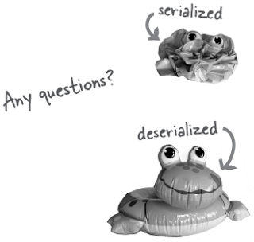
Serialization

Slide 10
Output Streams – Serializing
ObjectOutputStream
writeObject() – writes an object to the file
writeUTF() – writes a String to the file
flush() – flushes the Stream

Slide 11
Input Streams – Deserializing
ObjectInputStream
readObject() – reads an object from the file
readUTF() – reads a String from the file
readFully() – reads a Stream and saves its bytes in a
byte array

Slide 12

Summary
How do we read from a file?
Main two types of streams
Closing the streams
How do we serialize an object?

Slide 13








Streams and Files
https://softuni.bg/courses/java-fundamentals

Slide 14






Free Trainings @ Software University
Software University Foundation – softuni.org
Software University – High-Quality Education, Profession and Job for Software Developers
softuni.bg
Software University @ Facebook
facebook.com/SoftwareUniversity
Software University @ YouTube
youtube.com/SoftwareUniversity
Software University Forums – forum.softuni.bg

